Slide 1
Coursera Capstone Project
Analysis of Boston liquor license

Slide 2
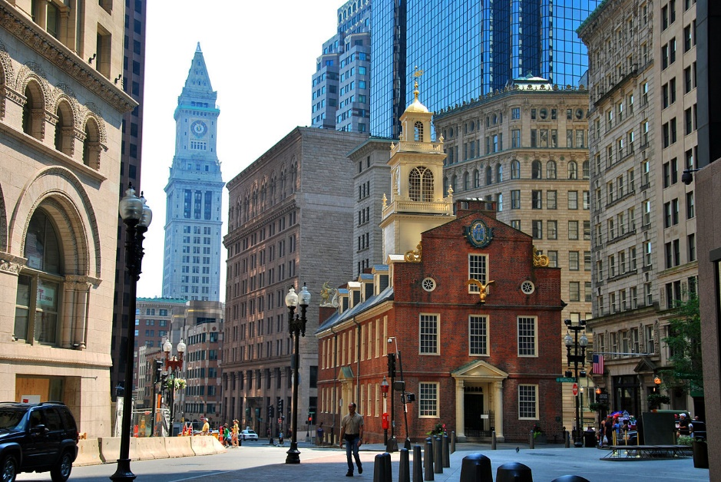
Introduction
One of large cities in USA with lot of history
Different Cultures
Modern city combined with traditional values
Some laws are still kept from old days

Slide 3
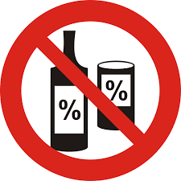
Problem
State mandates liquor license for alcohol distribution
Local government has task of evaluation and issue
For a potential entrepreneur, finding a possible location that can get a liquor license

Slide 4
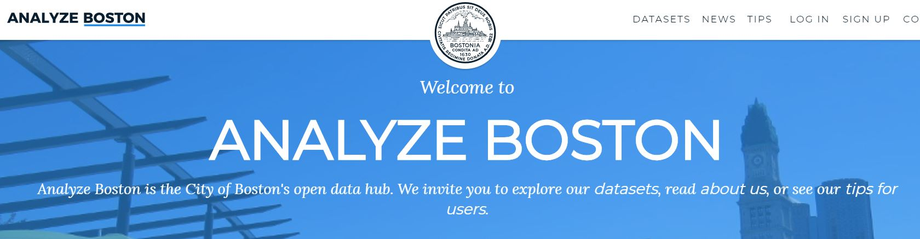
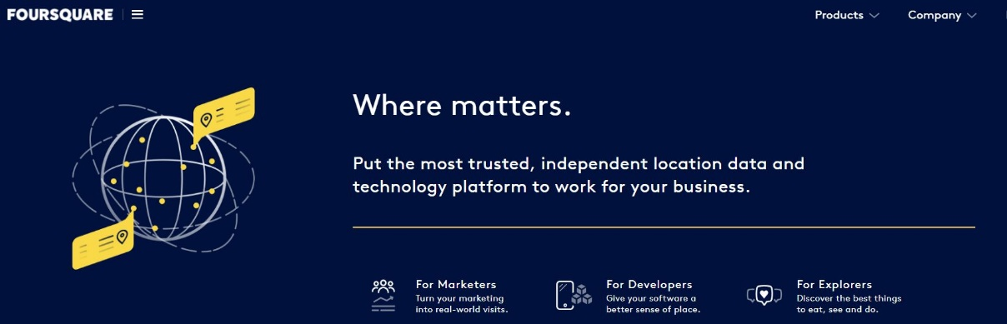
Data
From Boston government’s city data
Location data in latitude and longitude
Top venues data from Foursquare for the geo location

Slide 5
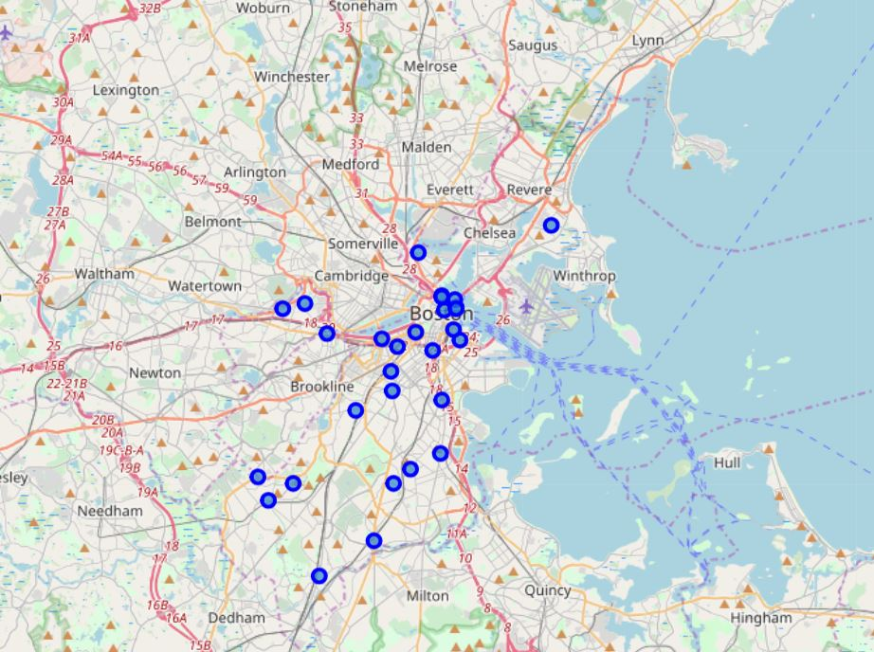
Analysis
Data collection and cleanup
One geo-location per zip code
Top venues from Foursquare

